Slide 1
Grand Knight
Training
Faith & Family First
Notes:
Audio Overview
Introduce yourself
This workshop is for…
Current Grand Knights (Regardless of experience)
Deputy Grand Knights (soon to become GK)
Thanks for volunteering.
Lot of work but very rewarding.
Shepard your councils and help them to be…
better men
Husbands
Fathers & sons
Christians
Overall message to get across…
You want them leaving this workshop
Excited, motivated and anxious to do a great job
Knowing the basic information to get started
Knowing where to turn for help – They are not alone

Slide 2
Congratulations on Being Elected Grand Knight
Information to all Members

Slide 3
Grand Knight Introduce Yourself Believe it or not, not all council members know you.

Slide 4
Brother Knights, thank you for electing me your Grand Knight. I believe many of you know me my name is William Leveque. I married my wife Cindy in 1988. We have 3 boys 1 girl and 3 grandchildren. I went to School here at STA and so did my children. We have been members of the Parish since 1964. I became a Knight here at STA 04/1996. I have been involved at both the Parish level and at the school. I am here to serve our councils need and have an open-door policy, if there is a program you want us to be involved with, please bring it to my attention, if there is something we can do better on the programs we run let me know If you want to chair a program let me know. I look forward to our future together. Sincerely GK William LeVeque , gk7816@mikofc.org, or 517-749-2011.

Slide 5
Part 2 : Message from State Program Director, Paul Palka, p.palka@mikofc.org What Programs can we do at our Council? Faith - Into the Breach video series Faith - Can Drive for Seminarians Family – Family Game Night Family – Food for Families Food Drive Community - Coats for Kids Drive Community - Keep Christ in Christmas Poster contest Life – Support of a Pregnancy Aid Center Life – Sponsor or help Sponsor an Ultrasound Machine These are just a few ideas, there are many more on our State and Supreme websites.

Slide 6
Part 3: Message from State Membership Director, Jim Escott, j.escott@mikofc.org Growing your councils is critically important for many reasons: • Council benefit – The more men you have in your council, the more programs you can do. It’s important to bring in new members for the long-term sustainability of your councils. • Church benefit – The Knights of Columbus is an important resource to help your parishes thrive and fulfill their mission. • Member benefit – The Knights help all men to become better men, better husbands, better fathers and better Catholics. Continued next page

Slide 7
Here is the list of the recruiting incentives for council members and councils for the 2023-2024 fraternal year: 1. A member recruits THREE new members in first six months (July 1 to December 31) - State Raffle tickets (book of 5 tickets) awarded (only awarded once to each member per year). 2. A member recruits SIX new members – The member then becomes a member of the Ambassador Club and receives KofC short-sleeve polo shirt. 3. A member recruits NINE new members – The member receives a Knights Gear gift certificate for $75. 4. A member recruits TWELVE new members will receive a Knights Gear gift certificate for $100.

Slide 8
Communication with all council members will help ensure success, this letter is the first step. Now unto some training.

Slide 9
Three Training Modules
Modules:
Building to Become Successful Grand Knight
Conducting successful meetings
Youth Protection Policy & Training
GK – Technology overview Video
Notes:
Audio Overview
Keys to success
Running effective meetings
Youth Protection
In a separate video I will cover various computer tools to help you including
Email
Websites
Click on the speaker icon to hear the audio for this page
Click on the Blue arrow icon to jump to this section
Click on grey arrow icon to link to a document, website or video
Click on the home icon to jump back to the beginning
Overall message to get across – This is what will be covered

Slide 10
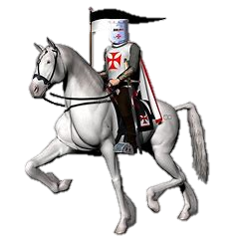
1st Module – Becoming a Successful Grand Knight
Becoming a Successful Grand Knight:
Start with a solid foundation
Build on your solid foundation
Resources – Where to go for help when needed
Notes:
Audio Overview
Becoming a successful GK – You can’t do everything all at once.
Start by focusing on these 9 things
Build on that and then do these things
Help
Overall message to get across…
Don’t become overwhelmed… Take it one step at a time
Focus on 9 fundamental things first.
Once those are handled, then focus on these additional items
Know where to go for help. You don’t have to remember everything

Slide 11
Solid Foundation
Surround yourself with great leaders
Insist your predecessor brings you up-to-speed
Get basic training
Create a working relationship with your Pastor
Run effective council & officer meetings (See Module 2)
Establish goals for the council and it’s members
Understand, embrace and implement Faith in Action
Focus on addressing your council’s biggest issues
Use the State Council’s e-mail system
Grand Knight
Financial Secretary
Program Director
Membership Director
Notes:
Audio Overview
These 9 things should be your main focus as you begin
Have these done by end of September (Q1)
These are the most important things to get you started
If you handle these first, the rest is much easier
If you miss 1 or more of these, your job gets a lot harder

Slide 12
Surround yourself with great leaders
Every minute you spend selecting your leadership team will save you an hour later in the year
The stronger your leadership team is…
The less work you need to do yourself
Don’t pick your friends or those who volunteer, pick those you think will do a good job.
Notes:
Audio Overview
Surround yourself with great leaders
If you try to do it all yourself, you’ll get burned out very quickly.
If you pick “weak” people…
You’ll end up doing it all yourself or
You’ll spend even more time trying to make your leadership team work and/or
You’ll have lots of issues which may seriously damage your council for years to come
Council Leaders are selected 2 ways:
Council Officers are elected (Due June 30th)
Service Program Personnel (Directors) are chosen (Due July 31st)

Slide 13
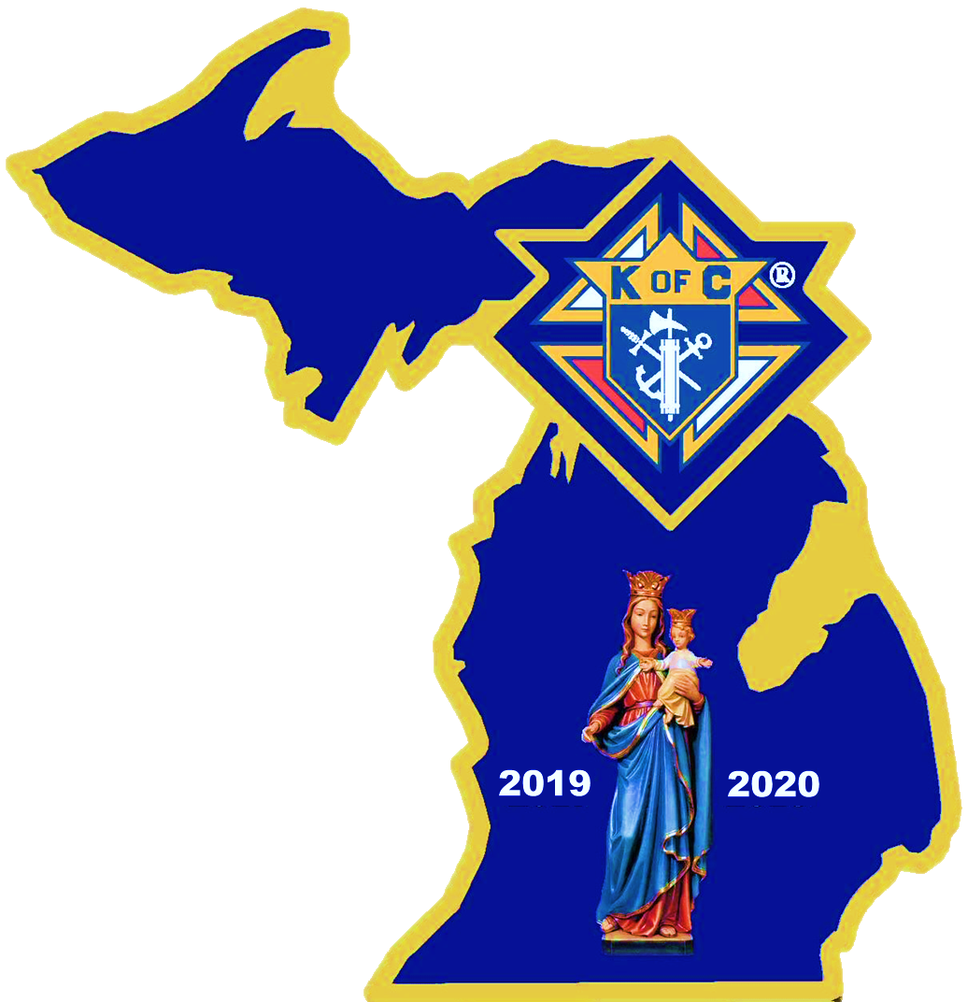
Build Your Councils Organizational chart
Elected
Chaplin
(Name)
Grand Knight
(Name)
Duties Responsibilities Council Officers Directors
Appointed
Deputy GK
(Name)
Treasurer
(Name)
Program Dir
(Name)
Membership Dir
(Name)
Chancellor
(Name)
Trustees
1 (name)
2(Name)
3(Name)
Family Dir
(Name)
Retention Chair
(Name)
Warden
(Name)
Community Dir
(Name)
Retention Committee
1 (name)
2(Name)
3(Name)
Fin. Secretary
(Name)
Outside Guard
(Name)
Life Director
(Name)
Recorder
(Name)
Inside Guard
(Name)
Faith Director
(Name)
Ins. Promotion
(Name)
Lecturer
(Name)
Advocate
(Name)
Formation
(Name)
Health Services
(Name)
Public Relations
(Name)
Notes:
Audio Overview
Here is a list of all Officers & Service Program Personnel
Blue boxes are Elected officers
Purple boxes are Appointed positions
Click on the link to see job descriptions for most of these positions

Slide 14
New Formation Director
1.) A Practical Catholic Male, a sincere devotion to the Catholic Faith and our brotherhood in Christ(Church attendance as often as possible/Confession a must,-time table based upon perceived need)These have specific Catholic guidelines - but It is not for me to judge.
2.) Outgoing and has, or can have a great relationship with the Pastor, and or the Parish's Evangelization Team.
3) A Man who has the time to make a commitment to hold the Cor Meeting monthly if not Weekly,and can lead a small group discussion.
4) A Man that is open and willing to listen to all points of view and is able to control a meeting.
5) A Man that wants to bring others to Jesus via Evangelization.
6) Willing and able to hold the podium at a meeting and not be thrown of course,
7) Someone willing to use opportunities to invite men to become a Knights of Columbus Member.
8) Finally, someone who is on a the Journey to become a better Catholic through discourse, readings and videos and seeks to grow in their faith through fellowship.

Slide 15
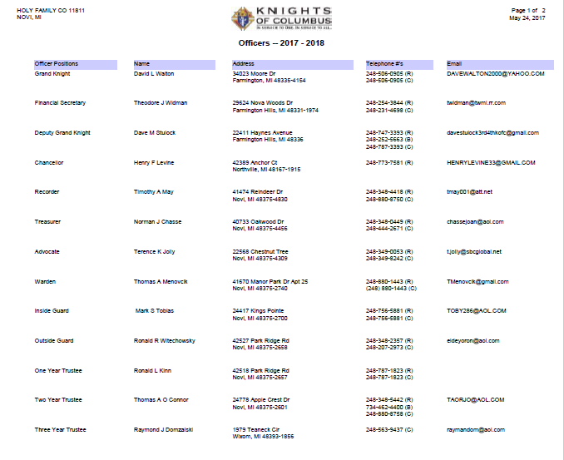
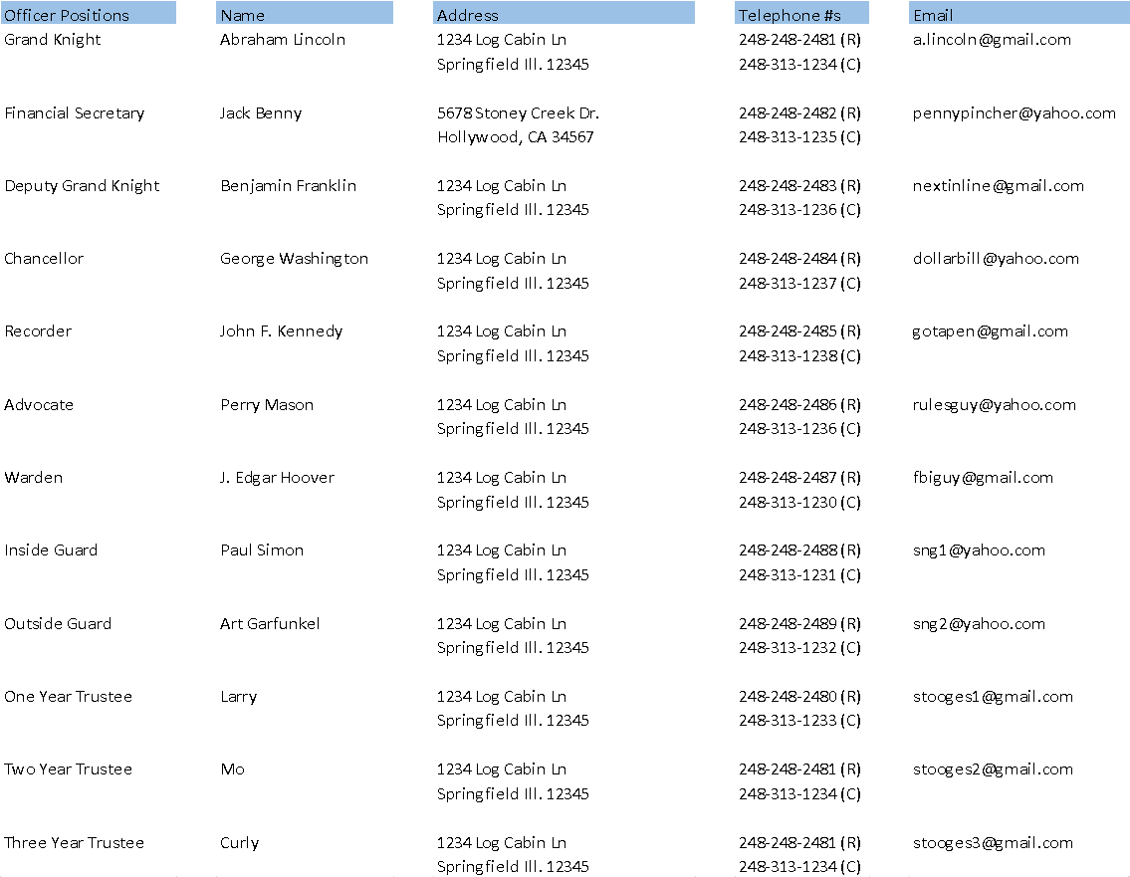
Council Officers Form # 185
Member Management Steps
Go to: www.kofc.org (click)
Sign in
Officers Online
Member Management
LIVE
Council Administration
Council Officers
Choose Role
Assign a Name
Submit
Print Center
Save & e-mail report
Form #185 Member
Management Video
Notes:
What to say…
Council Officers are voted on in May/June.
Form 185 needs to be submitted by June 30th (at the latest)
You can do this 2 ways…
Use the PDF version stored on the Supreme website
Submit this form using Member Management (Preferred)
Overall message to get across…
Grand Knight or Financial Secretary are the only two people who have access to Member Management.
Do this right after your council elections
Use the “Copy current year” button in MM to automate much of the process

Slide 16
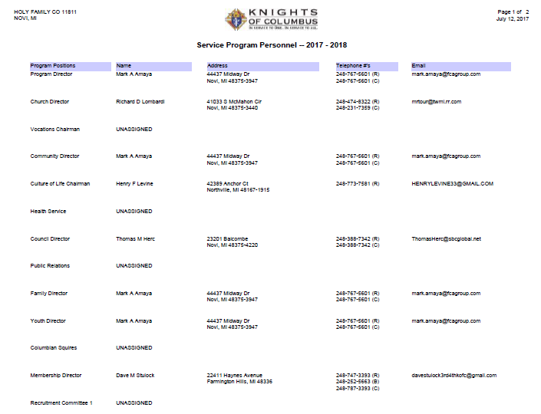
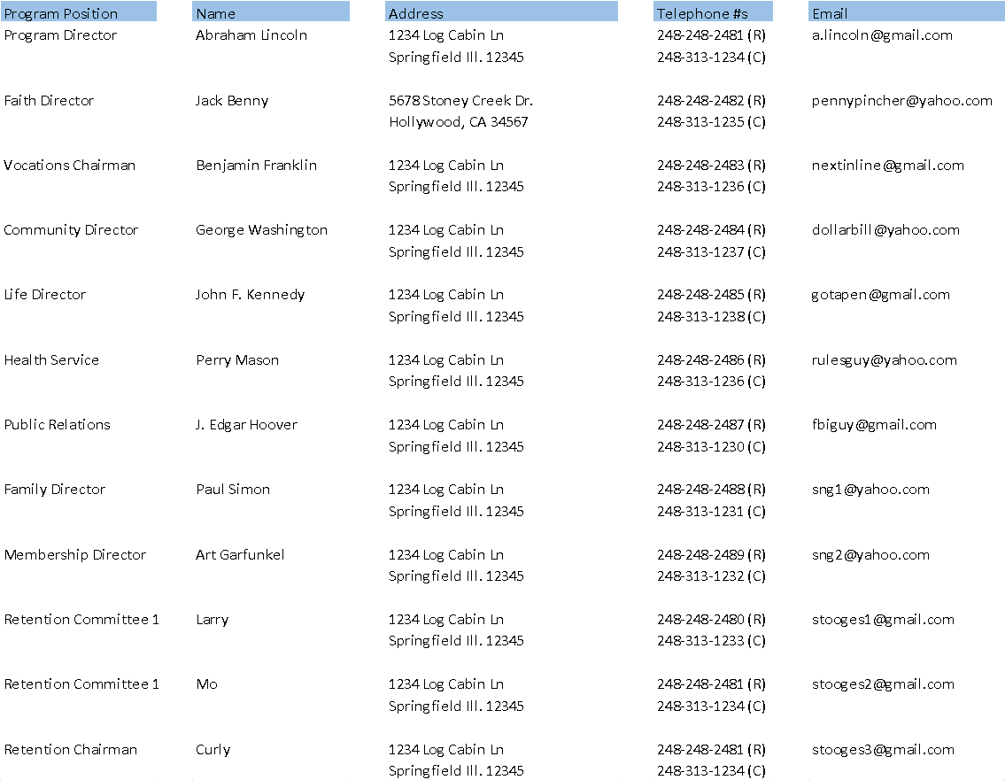
Service Program Personnel
Form 365
Member Management
Go to: www.kofc.org (click)
Sign in
Officers Online
Member Management
LIVE
Council Administration
Service Program Personnel
Choose Role
Assign a Name
Submit
Print Center
Save & e-mail report
Form #365 Member
Management Video
Notes:
Audio Overview
Service Program Personnel are chosen by the Grand Knight.
Form 365 needs to be submitted by July 31st (at the latest)
You can do this 2 ways…
Use the PDF version stored on the Supreme website
Submit this form using Member Management (Preferred)
Overall message to get across…
Grand Knight or Financial Secretary are the only two people who have access to Member Management.
Do this right after council elections (at least get an initial version submitted)
You can update this throughout the year as you get various positions filled.
Use the “Copy current year” button in MM to automate much of the process
5 mandatory roles need to be filled
Program Director
Community Director
Family Director
Membership Director
Retention Director

Slide 17
GK Transitions – Handing off the baton
Forms submitted previous 2 years
GK e-mail address & password
GK Jewel
Lessons Learned
Important issues facing the council
Your GKXXXX@mikofc.org account has a space on the google drive that you can store forms and documents. When you use the drive and hand off email and password it will allow the new GK to have the items he needs to take over smoothly..
Notes:
Audio Overview
Grand Knight Turnover - At a minimum, get these 5 things from the previous (out-going) Grand Knight
Forms – Review & understand these
GK email address and password
GK jewel
Lessons learned
Important issues facing the council
Overall message to get across…
I’ve seen too many GKs that just dump the job to the new guy.
Don’t let this happen to you.
Your predecessor should teach you
When you are done, you need to teach your successor

Slide 18
Basic Training
Important meetings to obtain critical information
Diocesan Meetings – Held every summer
District Deputy Meetings – Held at least twice / year
Leadership Guide (Provided @ Diocesan Mtgs)
Leadership
Council Administrative
Membership
Programs
State Calendar Forms Due Dates
Use google calendar and send out meeting invites to all members. This will help you increase attendance at meetings
Notes:
Audio Overview
Basic Training
Diocesan Meeting
Meet your State Leadership
Learn State & Supreme goals
Learn new information from State & Supreme
Get the Leadership Guide – Great directory of information
More one-way communication
District Meeting
Held at least twice a year (Summer & Winter)
Ties State & Supreme programs to Councils
More two-way communication

Slide 19
Basic Training
Supreme Material
Leadership Resources
Video Library
Michigan State Material
Building the Domestic Church
Ceremonials
Family
Forms
Youth Protection
Knights of Columbus (Supreme)
Praesidium - Knights of Columbus
Detroit Diocesan
Gaylord Diocese
Marquette Diocese
Officers Online
Training (Within Officers Online)
Membership
Manuals & Documentation
Officer Training Material
Publications
Lansing Diocese
Kalamazoo Diocese
Grand Rapids Diocese
Saginaw Diocese
Notes:
Audio Overview
Basic Training – This is a key page you should reference frequently
Supreme Material
Leadership Resources ( Guidebooks, videos, program information)
Video Library ( training, marketing and other videos)
Officers Online Key – Watch this video
Training Key – Take Grand Knight training
State Material
Forms (All State forms are here)
Membership (Lots of material to help in recruiting)
Manuals & Documentation (Very educational)
Officer Training Material (PowerPoints, PDFs & Videos)
Youth Protection
Knights of Columbus link
Link for each Diocesan Youth Protection Program

Slide 20
Relationship with Pastor
Become a Helpful part of His team
Set up a meeting to get to know each other
What does he want / need from the Knights?
How can you help?
Does he have issues with the Knights?
Become the council he wants you to be
Meet regularly to stay aligned
See “How to win over your Pastor” for ideas
How to Successfully Communicate with your Pastor
Notes:
Audio Overview
Pastor relationship – Bad Pastor relations is big problem for some councils
If your council has a good relationship – It’s your job to maintain (and improve) it.
If your council has a not-so-good relationship – It’s critically important to fix this.
Watch the Supreme video to see their Top 6 ideas
Refer to your Michigan Leadership Guide to see the Top 10 things to do
Overall message to get across…
Meet with your Pastor
Develop a relationship
Have your Council serve him & the Parish
Make him happy. Keep him happy

Slide 21
Establish Goals
Why not Star Council?
What do you want to accomplish?
Inputs
Outputs
Last Year Results
Program Plans
State Goals
Planning with Officers & Directors
Membership Plans
District Goals
Parish Goals
Insurance Plans
Council Goals
Financial Plans
Notes:
Audio Overview
If you fail to plan, you’re planning to fail.
Inputs – Have these available for your planning session
Planning – Meet with Officers & Directors to plan
Outputs – Develop these 4 plans
Programs Plans – Owned & managed by your PD
Membership Plans – Owned and managed by your Membership Director
Insurance Plans – Owned by GK (with FA)
Financial Plans – Owned by FS, Treasurer & Trustees
Overall message to get across…
Have a plan
Get your officers and Directors to “own” their components
Meet “at least quarterly” to review & adjust

Slide 22
Have Action Plans tied to your goals
Goals can’t be accomplished w/o an Action Plan
Step-By-Step
Keep each step attainable, easy to identify as being completed
Time-Line (make it realistic)
Who’s going to do what, when
Notes:
Audio Overview
Have an action plan
Quarterly objectives
Assign responsibility to your leadership team
Review quarterly
Overall message to get across…
Make a plan (July)
Work the plan (monthly)
Review the plan and adjust as necessary (quarterly)
Share the plan with your council, District Deputy & Pastor (quarterly)

Slide 24
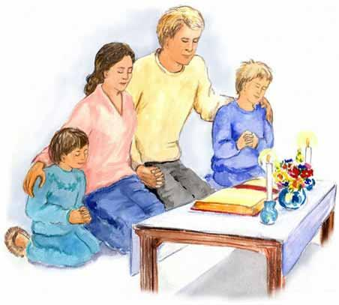
Building the Domestic Church
It is believing that how you live your faith in your councils, families, parishes and community has a ripple effect that changes the world
It is knowing that your actions speak louder than your words
It is the council, the family and the parish that knows that everything they do must be based in prayer
Building the Domestic Church
Notes:
Audio Overview
BDC – The Faith In Action program model is based on Building the Domestic Church
Overall message to get across…
Check out the link to learn about BDC

Slide 25
Faith in Action Programs
Building the Domestic Church is the foundational model for Faith In Action Programs
The goal is for men to lead their family in service — not leave their family for service
Building the Domestic Church is the GOAL
Faith In Action is the action plan
Highlights opportunities to make a meaningful difference
Focuses on Faith, Community, Family, & Life
Notes:
Audio Overview
BDC is the goal, FIA is the action plan

Slide 26
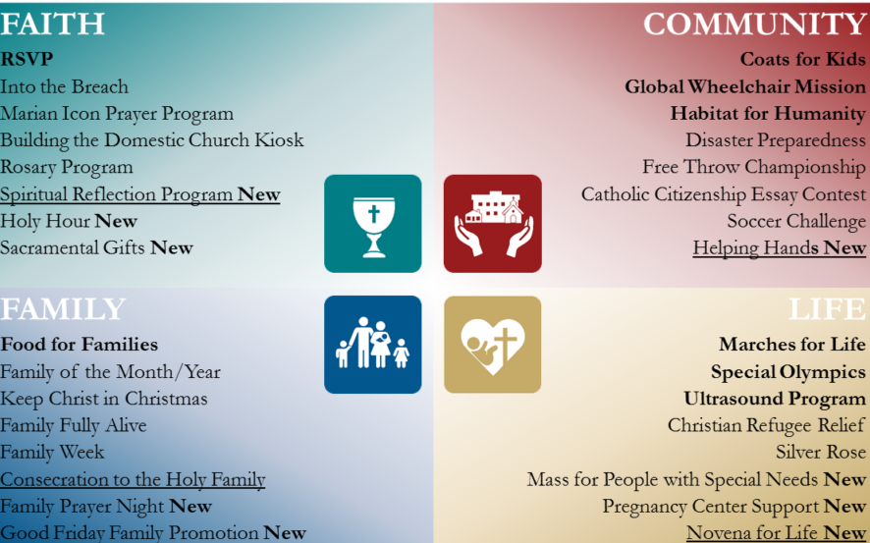
Building The Domestic Church & Faith In Action
What to do
Get educated (Explore the web pages for)
Building the Domestic Church
Faith In Action
Talk with your Pastor
Define activities
Plan Them
Do them
Click for planner
Use the Faith in action planner
Notes:
Audio Overview
Get educated on FIA, talk to Pastor to get him on board, decide what to do & do it
Overall message to get across…
Have your Program Director take the lead
You and your Program Director should both learn BDC & FIA
You and your Program Director should meet with your Pastor
Have these plans spelled out in your Council Plan

Slide 27
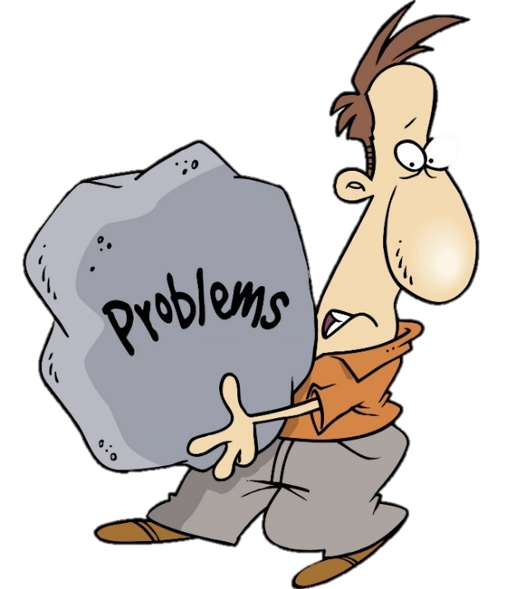
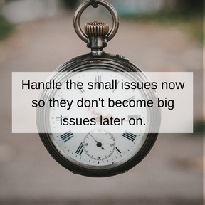
Bad news does not get better with time
Address problems
The SOONER the BETTER
Seek out the hot issues from others
Prioritize them
Step up and fix the biggest issue first
Notes:
Audio Overview
Address problems – Bad news does not get better with time.
Seek issues from Previous GK, Pastor, District Deputy, Council and You.
Prioritize them (Rank them by importance & difficulty)
Fix them (No more than a couple at a time)
Delegate some to your Council Officers and Directors if possible.
Overall message to get across…
Problems…
Won’t go away on their own
Get worse with time
The more problems you solve, the more fun & successful your council will be

Slide 28
What’s Next?
Build on a solid foundation
Star Council Award
Forms – Communicate to Supreme & State
Oversee personnel who impact Star Council Goals
Mentor & Develop your leaders
Notes:
Audio Overview
Start with a Solid Foundation - Make sure you start with the 9 items discussed in the previous section
Build on your Solid Foundation - Then, you can (and should) work on these items
Overall message to get across…
These items are important (but not as important as the “1st things 1st” items
Star Council – Indicates your council is healthy and vibrant
Forms – Keep State & Supreme aware of your progress
Oversee personnel to ensure they are successful
Mentor & develop leaders – Leave your council better than you found it

Slide 29
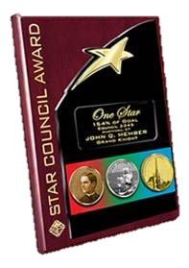
Star Council Award
Attain Membership Goal
Attain Insurance Goal
Attain Program Goals
Complete and submit required forms
#1728 - Annual Survey of Fraternal Activity - PDF - Online
#185 - Report of Officers Chosen for Term - PDF - Online
#365 - Service Program Personnel Report - PDF - Online
SP-7 – Columbian Award Application - PDF - Online - Instructions
Make all per-capita payments
Youth Protection Training
More Details Supreme Website
Notes:
Audio Overview
Star Council – 6 requirements – These represent a great, healthy council
Meet or exceed your Membership Quota
Meet or exceed your Insurance Quota
Meet or exceed doing all required programs
Complete and submit required forms
Pay all State & Supreme per capita payments
Obtain Youth Protection Compliance
Overall message to get across…
It’s a hard award to earn but…
It’s a great accomplishment
Your council will be very proud
Your council is in great shape (very healthy)

Slide 30
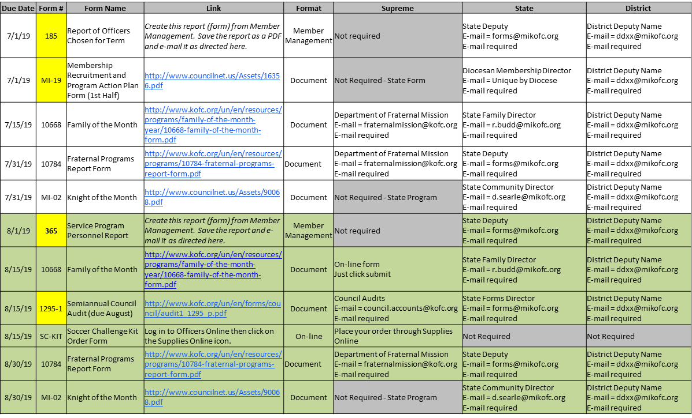
Forms Minimize effort Maximize value
Minimize changing who fills them out
The GK IS responsible, regardless of who fills it out
Use the previously submitted form as a starting point
Discuss up-coming forms at every Officers meeting
On-time (or early) minimizes frustration
Paper Forms take Supreme 6 to 8 weeks to process
Use tracking matrix for check list (see tip!)
Watch this video to see where to find all forms
Use the tracking spread sheet to help keep you on track!
Notes:
Audio Overview
Forms – Similar to CEOs of companies, preparing & submitting forms is a main part of the job.
Watch the video to see where to find forms
Supreme forms
Michigan forms
Forms tracker spreadsheet

Slide 31
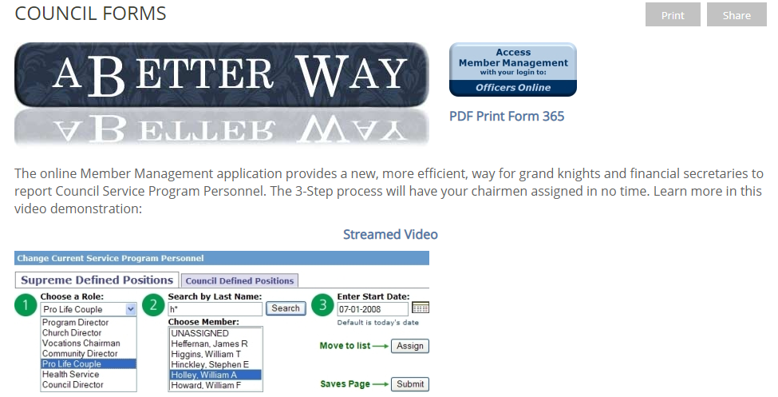
Critical Forms
185 – Report of Officers Chosen
365 – Service Program Personnel Report
Form 10784 – Fraternal Programs Report
Form SP7 – Columbian Award Application
1728 – Annual Survey of Fraternal Activity
1295 – Semi-Annual Audit
Form 10784 – Special Olympics
Critical forms are highlighted in Yellow on tracking spread sheet!
Click here to stream how to for online forms
Notes:
Audio Overview
These are the most important forms to due throughout the year
Due date
Form #
Form Name
Video (how to fill out the form) or…
Link (where to find the form)

Slide 32
Oversee Council Leadership
Show your interest
Provide direction
Let them do their job
Program Director
Membership Director
Financial Secretary and Treasurer
Insurance Agent can help
Notes:
Audio Overview
Oversee Council Leadership – Get to know them, treat them as individuals
Stronger leaders – Count on them but thank them continuously
Weaker leaders – Help them & recognize the good things they do
Motivate them to do more

Slide 33
Develop Leaders
Good to Great
Have subject matter experts teach others
Work with your weakest leaders
Do they each have back-ups / replacements?
What do they want to do next?
Are they having fun?
Are there new people who want to move up?
“The Four Keys of Great Managers:
1. "When selecting someone, they select for talent ... not simply experience, intelligence or determination."
2. "When setting expectations, they define the right outcomes ... not the right steps."
3. "When motivating someone, they focus on strengths ... not on weaknesses."
4. "When developing someone, they help him find the right fit ... not simply the next rung on the ladder.”
― Marcus Buckingham
Notes:
Audio Overview
Develop leaders – As the Council CEO, it’s your job to develop future leaders
Have good people pass on their knowledge and experience
Help weak leaders (but don’t waste your time)
Get back-ups, replacements, assistants for each
Know what they want to do next
Make sure they’re all having fun
Find new people (others) who want to be leaders & get them engaged

Slide 34
Resources Officers Online
Watch the Officers Online Overview Video
LEADERSHIP RESOURCES
LEADERSHIP
Use these documents as tools to enhance your knowledge as a fraternal leader in the Knights of Columbus. The instructions, rules and advice provided in these resources will help you in setting an example of charity, unity and fraternity.
#5085 - Grand Knight's Guide #5087 - District Deputy's Guide #5089 - Financial Secretary's Guide #945 - Chaplain's Handbook #5033 - Fraternal Leader Success Planner #10318 - Method of Conducting Council Meetings #1612 - Protocol Handbook #10238 - Summary of FS's Responsibilities #30 - Charter, Constitution and Laws of the Knights of Columbus #5093 - Leadership Resources
Notes:
Audio Overview
Leadership Resources
Leadership Guide
People to see for help
Past / Present council officers
District Deputy
Diocesan Directors & SDRR
State Officers and Directors

Slide 35
Module 1 Summary & Resources
Fresh Start workshop – Great start
Leadership Guide – Provided @ Diocesan Meetings
Method of Conducting Council Meetings (#10318)
Supreme – (www.kofc.org) Under “For Members,” look for “Resources,” then look for “Officer Guides,” and, “Membership Resources”
State – (www.mikofc.org) Under “Resources,” look for training material under “Manuals and Documentation,” then, “Council Materials”
Youth Protection Training
Past & Present Council Officers
District Deputy – Outside of your council ALWAYS start here
State Officers & Directors (your DD will assist)
Notes:
Audio Overview
Resources
Leadership Guide
Supreme & State Website material – discussed with Basic Training (Page 9)
Youth Protection - discussed with Basic Training (Page 9)
Officers Online – Lots of good info – watch the video
People to see for help
Past / Present council officers
District Deputy
Diocesan Directors & SDRR
State Officers and Directors

Slide 36
2nd Module - Running Successful Meetings
Running successful meetings:
Grand Knights roles and responsibilities
Before the meeting – Preparation
During the meeting – Effective Execution
After the meeting – Follow up
Watch this video on how to run a successful council meeting
Notes:
Audio Overview
Running Successful meetings – Prepare, execute & follow-up
Poorly run meetings – Members don’t come, fall away & council begins to die
Well run meetings – Generates enthusiasm, motivates people & councils thrive

Slide 37
Roles & Responsibilities
Men don’t join the Knights to pay dues and go to meetings
Facilitate – Don’t dominate
Fun – Meetings should be enjoyable
Informative – Communicate valuable information
Interesting – Not boring
Moving – Don’t let things get off track
Goal: Have your members leave the meeting saying… “Wow! That was a great meeting!!!”
Notes:
Audio Overview
Page 25: GK – Roles and responsibilities – Run GREAT meetings

Slide 38
Before the Meeting Preparation
Review “The Method of Conducting Council Meetings”
Plan the agenda
Review previous meeting minutes & notes
ID topics to be carried over (Old Business)
ID new topics (New Business)
Review Dan Remeika’s “Talking Points”
Communicate the agenda
ID important topics, discussions, or, votes
Notes:
Audio Overview
Page 26: Prepare for the meeting
Plan the agenda – Keep the meeting to 60 minutes (90 tops)
Send out the agenda for all to read

Slide 39
During the Meeting Execution
Start on time, every time! – Will help you end on time
Follow the agenda – Park new items for future discussions
Make a list of YOUR Action Items – For your Follow up
Assign responsibilities/tasks – For others to follow up
Confirm next steps
Don’t get “bogged down”
Use “Robert’s Rules”
How to Conduct a Meeting Pamphlet
Have your council’s ADVOCATE help control the meeting
DO NOT revisit an issue/vote UNLESS
New data, or, information becomes available that could impact the original decision, or,
Circumstances have changed which affected the original decision
Notes:
Audio Overview
Page 27: During the meeting – People hate meetings that drag on and on
Start on time
Follow the agenda
Assign action items (to you and others)
Let you Advocate be the bad guy if things get off track
Don’t revisit items (beat a dead horse)

Slide 40
After the Meeting Follow up
Publish meeting minutes
As soon after the meeting as possible
Follow-up
Who’s doing what, when
Including YOUR Action Items
What are next steps
Notes:
Audio Overview
Page 28: After the meeting
Get the meeting minutes out (email and/or website)
Ensure action items are followed up on (especially yours)

Slide 41
Effective Meeting Tools
Lots of beneficial information available
Michigan State Council at www.mikofc.org
“How to Conduct a Meeting Pamphlet”
Many other references. Go to “Resources”
Supreme Council at www.kofc.org
“Robert’s Rules Of Order”
Notes:
Audio Overview
Tools / Resources
How to conduct a meeting pamphlet is on our Michigan State website
Robert’s Rules of Order are very standard & can be found anywhere

Slide 42
The Method of Conducting Council Meetings
Everything you ever wanted to know about conducting a meeting, but were afraid to ask
Council chamber set-up
Duties & responsibilities
Conducting Officer & Council meetings
Parliamentary Procedure
Motions
Voting
“The Method of Conducting Council Meetings”
Notes:
Audio Overview
Page 29: Tools / Resources
How to conduct a meeting is from Supreme
How to conduct a meeting pamphlet is on our Michigan State website
Robert’s Rules of Order are very standard & can be found anywhere

Slide 43
3rd Module Youth Protection
Why is this important?
Who needs training & what do they need?
How to sign up for training
Armatus Site
Class 1 – Meet Sam
Class 2 – Duty to Report
Class 3 – KofC Safe Environment Policies
Background Check
Armatus Administration
Notes:
Audio Overview
Page 30: Youth Protection Overview – Youth Protection has dramatically increased in importance over the past 4 years.
Who needs training
What are the requirements
When – End of Q1
Where – Praesidium & you individual Diocese
How to sign up
Why is it needed

Slide 44
Why is this important?
There is no greater priority within the Order than the safety, security and protection of the children and young people who participate in its youth programs.
To help ensure the selection of only the best youth leaders for our programs, the Knights of Columbus has instituted the Safe Environment Program.
Notes:
Audio Overview
Carl Anderson – Our Safe Environment Program safeguards children and other vulnerable persons, assures members and their families that we maintain a safe environment, protects members from awkward situations, misunderstandings, and appearances of impropriety, builds trust with arch/dioceses and parishes, and protects the good name of the Knights of Columbus.
Knights help those who can’t help themselves
We need leaders who keep their eyes open & ensures our children are safe

Slide 45
Who needs Training?
Praesidium Training Here
Position | Meet Sam | Duty to Report Mandated Reporter | KofC Safe Environment Policies | Background Investigation
Grand Knight | Required | Required | Required
Program Director | Required | Required | Required
Community Director | Required | Required | Required | Required
Family Director | Required | Required | Required | Required
Notes:
Each council needs 4 positions trained in Youth Protection
Grand Knight
Program Director
Community Director
Family Director
All these positions are required to be filled for all councils
It’s best to have 4 different people fill these 4 roles but…
You can have 1 person fill “up to” 2 of these roles
GK can also be the Community Director
PD can also be the Family Director
You cannot have 1 person hold 3 (or 4) of these roles
All 4 positions need to take the 3 classes
Meet Sam
Duty to Report
Knights of Columbus Safe Environment Policies
Community Directors & Family Directors also need to have a background check done

Slide 46
STAR Council Award
Attain Membership, Insurance & Program Goals
Complete and submit required forms
Make all per-capita payments (Supreme & State)
Youth Protection Training
Grand Knights, Program Directors, Community Directors & Family Directors must all take 3 classes.
Community & Family Directors also need to have a background check done.
Plus, your council needs to comply with all Youth Protection Requirements for your Diocese.
All appointments and requirements must be completed, and reported by May 1st
Notes:
Audio Overview
Page 33: Star Council
Youth Protection certification is required to earn the Columbian Award (Program Award)
Columbian Award is required to earn Star Council

Slide 47
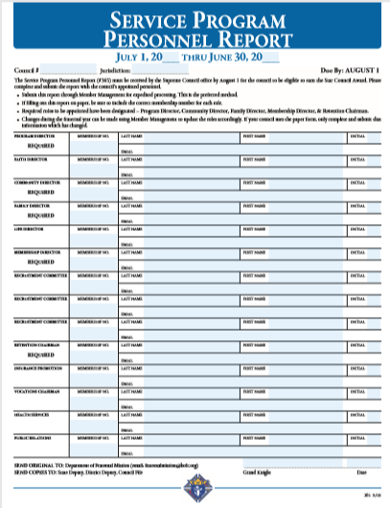
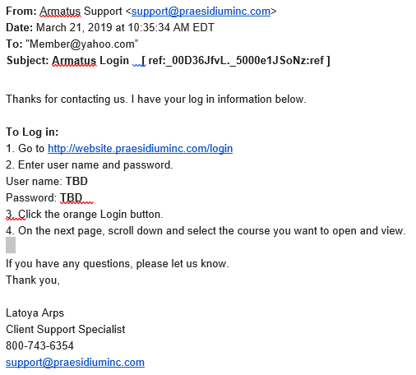
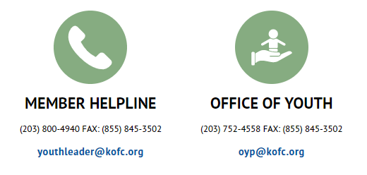
Youth Training Process
Council submits Service Program Personnel (form 365)
Supreme notifies Armatus / Praesidium
Praesidium sends e-mail to members for training
Notes:
Audio Overview
How to sign-up for training
Submit form 185 (For Grand Knights & form 365 for Directors
Watch the video to see how to submit the form 365
Supreme will notify Praesidium
Praesidium will send an

Slide 48
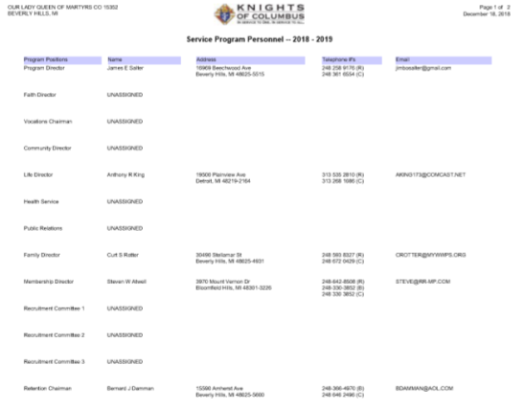
Service Program Personnel Report
Option 1: Submit form 365 = Service Program Personnel Report
Option 2: Filling Service Program Personnel via Member Management
Option 2 is preferred for the following reasons:
Supreme is notified immediately (nothing needs to be sent to Supreme)
Minimizes chance of human error (misplace forms, etc…)
Key things to keep in mind:
Ensure forms contain accurate and updated e-mail addresses for the members. (Otherwise, they will not receive the e-mail notice to take the training)
This form is due August 1st
Click here to stream how to
for online forms
Form 365
Notes:
Audio Overview
Forms 185 & 365
Grand Knights are assigned with form 185 (Due July 1st)
Program, Community & Family Directors are assigned with form 365
I discussed the forms earlier in this training
Please use Member Management if possible (All GKs and FSs have access)
Issues I’ve seen with these forms…
Tell someone when you assign them as a Program, Community or Family Director.
Tell them they are required to take classes and submit a background check.
If they have an email address, please make sure you put in on the form & ensure it’s a valid email.
If they don’t have an email address, put one on the report anyway
Maybe they have a family member who has an email address
Maybe another Knight can use his email & help this person through his training (get him logged in)
Make sure members don’t have filters to stop emails from unknown sources

Slide 49
Praesidium sends e-mail to members
Click on this link to access the ARMATUS training website.
Use the User Name provided here
Use the temporary password provided here
Notes:
Audio Overview
Page 36: Praesidium sends email to members for training
The email comes from Armatus Support (Not Supreme)
Read it & follow the instructions (it’s pretty easy)
Note the name & phone number to call for help

Slide 50
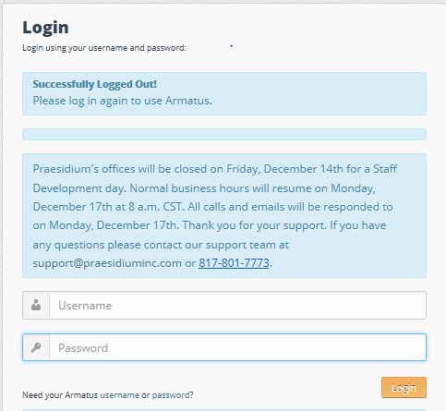
Praesidium sends e-mail to members
Notes:
Audio Overview
Follow the instructions
Click on the link
Enter your user name (Member # & last name)
Enter your password (kofcsafe is the default password)
Click on the orange LOGIN button

Slide 51
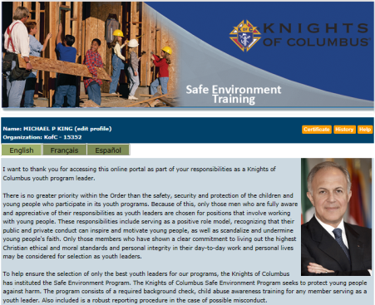
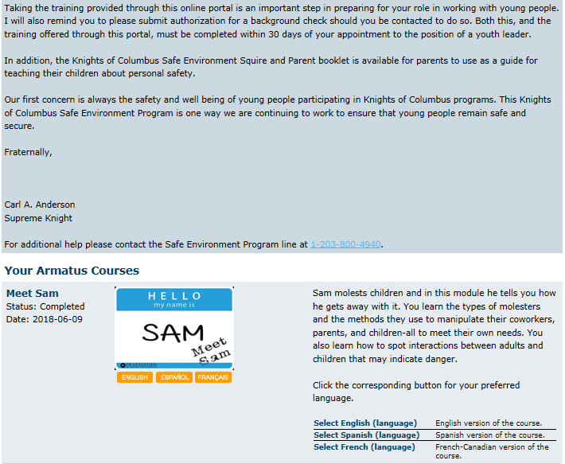
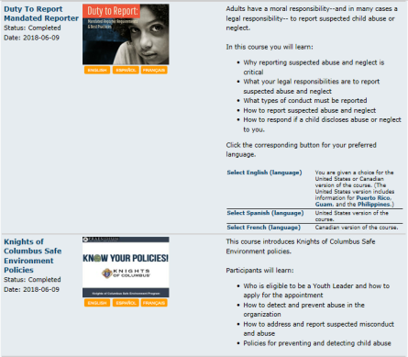
Armatus Site - Praesidium
Letter from Carl Anderson – Please read as this explains why this is so important.
Meet Sam – This is the first (of 3) classes. Click on “Meet Sam” to take this class.
Duty To Report – This is the second (of 3) classes. Click on “Duty To Report” to take this class.
KofC Safe Environment Policy – This is the third (of 3) classes. Click on “KofC Safe Environment Policy” to take this class.
Background Check (not shown here) must also be selected by all Community Directors & Family Directors.
Armatus Administration is a very useful tool for Grand Knights to use to monitor the training progress of council members.
Notes:
Audio Overview
Armatus Site
Letter from Carl Anderson
Meet Sam (1st class – see status next to the class)
Duty to Report (2nd class – see status next to the class)
KofC Policies (3rd class – see status next to the class)
Armatus Administration shows a status report for you council
Above Carl Andersons picture, click on Certificate to view, save & print your certificate)

Slide 52
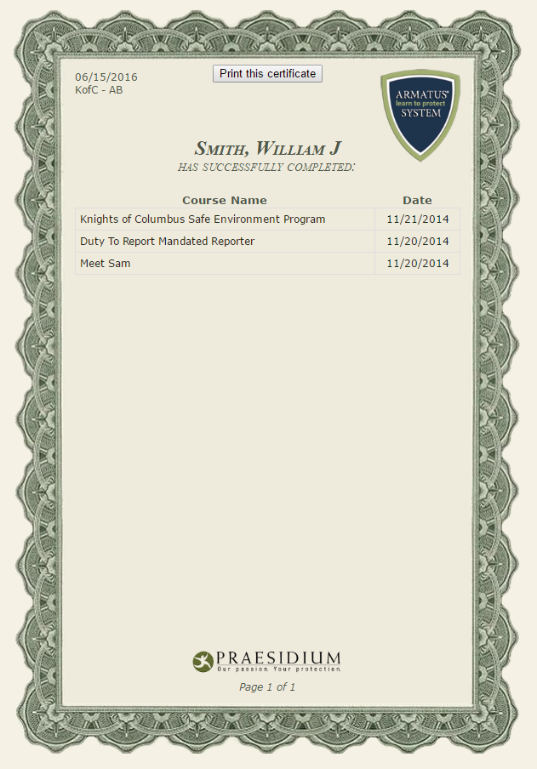
Training Certificate
Print or save your course completion certificate
Send a copy to
Your Grand Knight
Your District Deputy
Your Name Here
Notes:
Audio Overview
Training Certificate
All 3 classes MUST appear
It’s a PDF file
Print it
Save it to your computer
Send a copy to your Grand Knight & District Deputy
If it doesn’t list all 3 classes, you’re not done

Slide 53
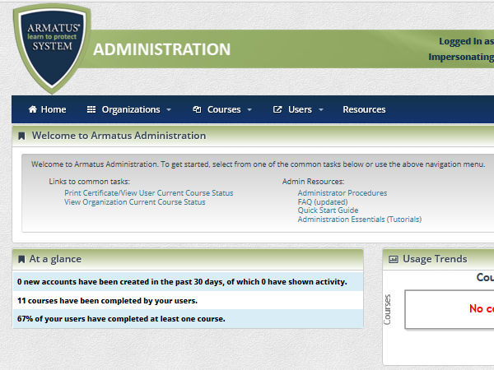
Armatus Administration - Praesidium
Click on this link to see the current course status of everyone who is registered for training in your council.
Note: If you left a position blank on your Service Program Personnel report, the person will NOT show up on this report. So, even if this report says all classes are complete, your council may not be compliant.
Notes:
Audio Overview
Armatus Administration
Only available to Grand Knights and Program Directors
Click on “View Organization Current Course Status” report

Slide 54
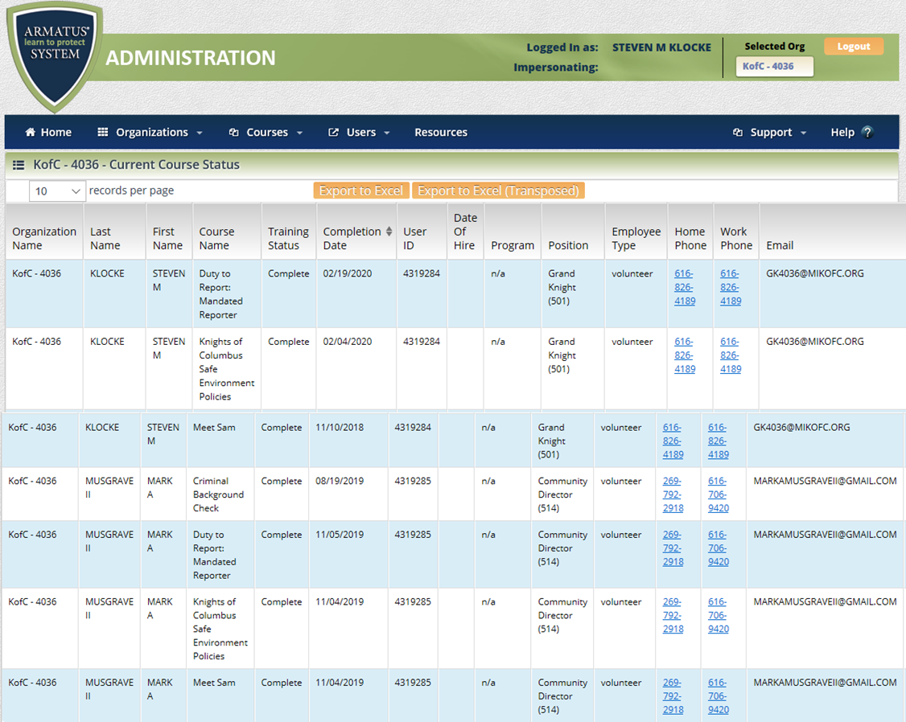
Armatus Administration – Praesidium
Notes:
Audio Overview
Shows lots of detail and exact status of your council
Each of the 4 roles should show up (but only if the role is assigned)
GKs and PDs should have 3 lines (one for each class)
CDs & FDs should have 4 lines (1/each class + 1 for a background check)
Each line tells you
Council #
Name
Course
Course Status (if it doesn’t say Complete, it’s NOT done)
Completion Date
User ID = Membership #
Position (GK, PD, CD or FD)
Home & Work Phone #
Email Address (Make sure it is filled in AND correct)

Slide 55
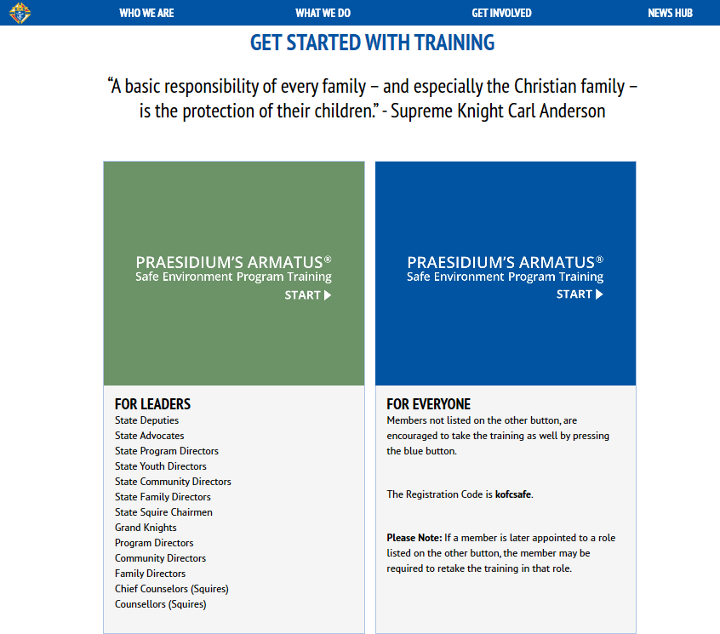
One Last Item on Armatus Training
Note: The Grand Knight, Program Director, Family Director and Community Director must complete the training to qualify for Columbian and Star Council award. Any member can take the training and you should encourage others in you council to take the training using the registration code ”kofcsafe”.
Youth Safety is Critical!
Notes:
Audio Overview
Anyone in your council can take these Youth Protection Classes
Green link is for those required to take the classes
User ID and password is required
These certifications are tracked by Supreme
Blue link is for anyone else that wants to take the classes
A Temporary user ID and password is provided
Supreme does NOT track anyone certified with this link

Slide 56
Questions?
Council Officer Fresh Start Program
Notes:
Audio Overview
Page 42: Final Page
Thanks again for volunteering
This really can be very rewarding IF you spend the time to do it right
Don’t do it all yourself – Count on your council to help you – Delegate
Don’t hesitate to ask your DD, Diocesan Directors and State Directors for help – That’s what they are there for

